Slide 1
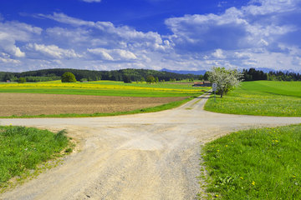
CATALONIA, A CROSSROADS IN EUROPE
WQ4 - COMIC (HI)STORIES
ESCOLA EL CASTELLOT
LA MÚNIA - CATALONIA

Slide 2
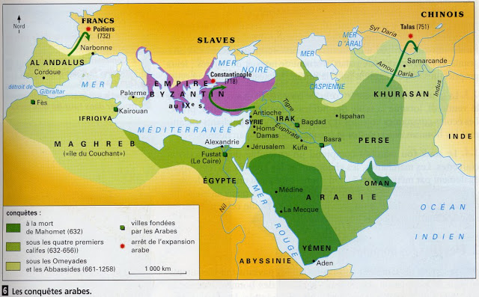
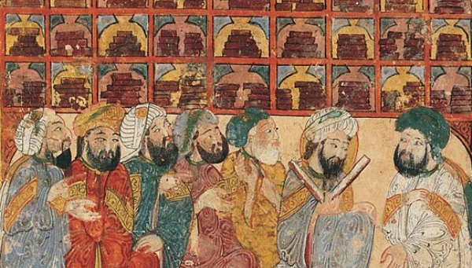
Our country, Catalonia, has been occupied by, among others, romans, visigoths and moors. The Moorish people were those who stayed the longest in our country.

Slide 3
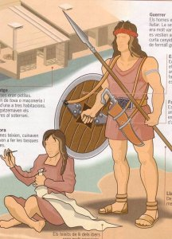
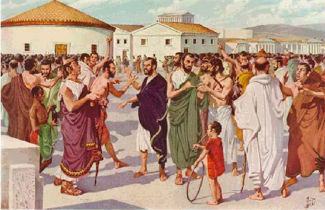
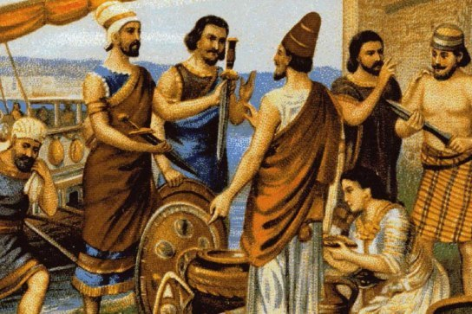
Before them, other people lived in Catalonia such as the phoenician, the Ibers and the Greeks.
Ibers
Phoenician
Greeks

Slide 4
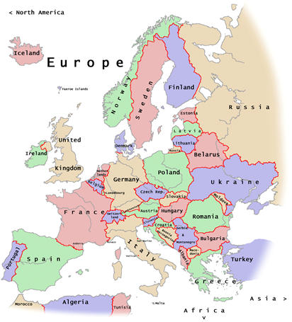
Like a corridor
Catalonia has always been one of the “crossroads” of Europe.
.
……...
-Armies, people going from the Ibenian
Peninsula to Europe , and backl.
Armies and people going from the Iberian Peninsula to the rest of Europe and back would cross, and sometimes stay, in this region.

Slide 5
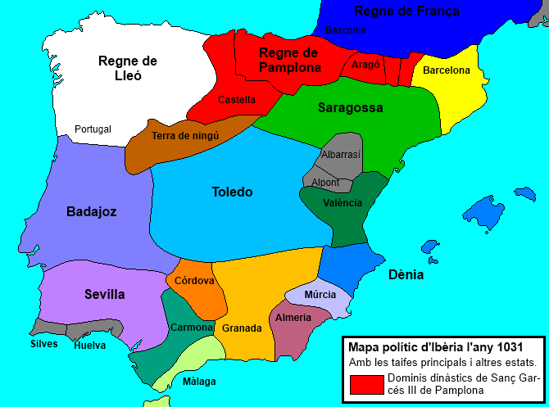
Iberian Peninsula in 711.
The Moors arrived to the Iberian Peninsula in 711.
They beat the Visigoth king and reached and crossed the Pyrenees into France.
There they met some very fearsome pepole: the Franks (the old French).

Slide 6
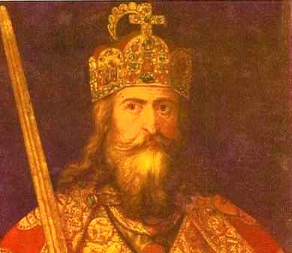
Carles Martell
The Frank king Carles Martell (Charles Hammer) defeted the moors, and they went back south crossing the Pyrenees with their tails between their legs.

Slide 7
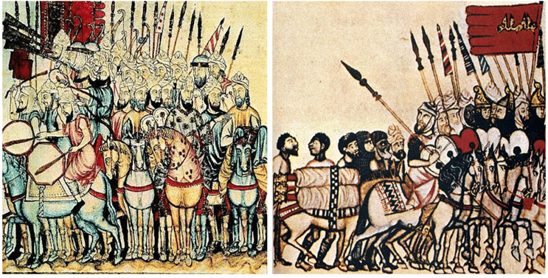
ACEIFES
However, the Moors croossed the Pyrenees many other times. Every summer they organised a big army and croossed into the Frank’s land. They destroyed everything they found. And after lots of fighting, they went back home with a large amount of booty and lots of prisoners.

Slide 8
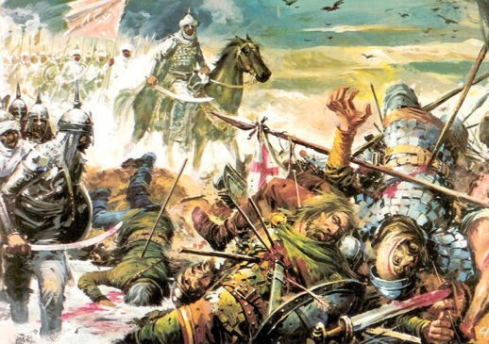
Those terrible Moorish expeditions were called “aceifes”.

Slide 9
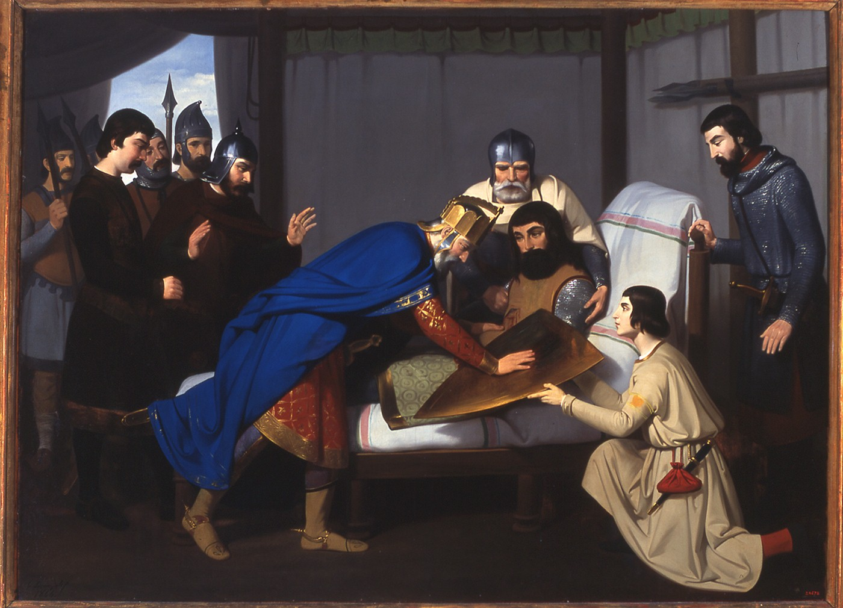
GUIFRÉ EL PILÓS
And it was because of those “aceifes” that our country started to appear in Frankish history.
Afterwards this recognition was increased with the help of a big important character called Guifré.
Obviously, the Franks were fed up with the Moorish summer visits! But they couldn’t help much: there were not many of them, and they spent most of the time fighting amongst themselves.

Slide 10
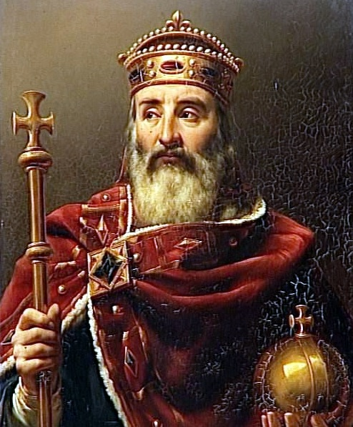
CHARLES CHARLEMANGE
However, in the Frankish kingdom, a character appeared who would change everything… His name was Charles, but history knows him as Charles the Great or Charlemagne.
Charlemagne was the son of a Frankish king (he had a funny name: Pipí el breu). He managed to get all the Franks to stop fighting each other. He organised a big army and founded a big empire. He was soon crowned Emperor.

Slide 11
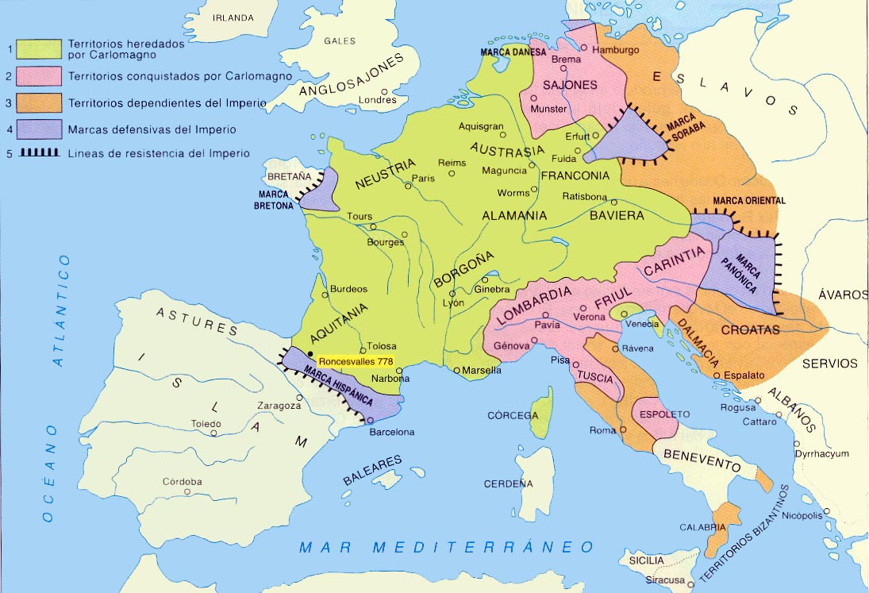
Charlemagne spread his Empire to most of Europe (see map).
But it was hard for him to establish at the South of the Pyrenees… Moorish were difficult to beat.
He wanted to set his borders down to Ebre river, so that aceifes wouldn’t cross the Pyrenees. But he only managed to get to Barcelona.
Ebre river
Barcelona

Slide 12
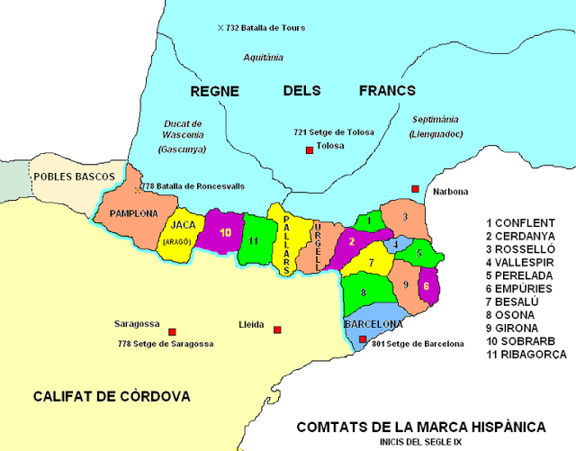
Marca Hispanica
In other lands Franks had conquered, they created a land barrier or “mark” and would install a “Marquis” there.
But in Catalonia, the Franks decided to divide the territory into counties, with a Count as the head of each one. The new counties mostly corresponded to the old divisions that had been established by the Romans centuries before.
The new Counts were French. Charlemagne didn’t trust the local nobles, despite the fact that they had helped him a lot to conquer the land.

Slide 13
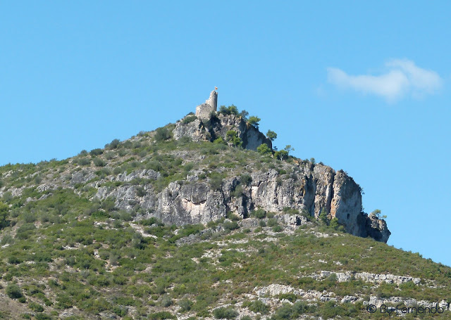
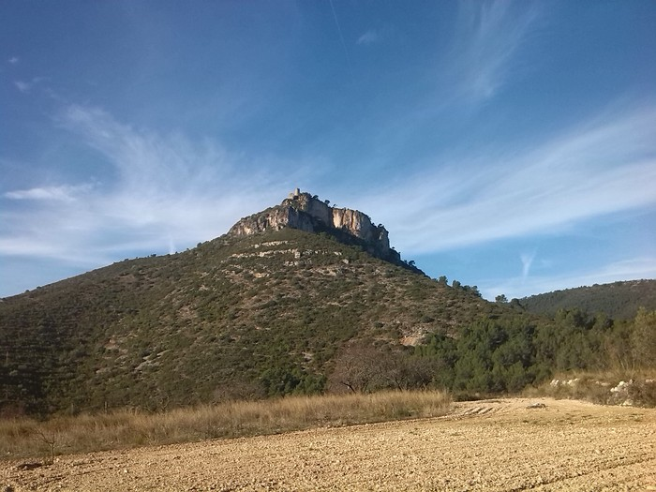
La Múnia - Castellví de la Marca
The name of our Municipality (Castellví de la Marca) comes from those times, where castles and towers were built to watch out for “aceifes”.
That’s why our “Castellot” was built, and our school is named after it.

Slide 14
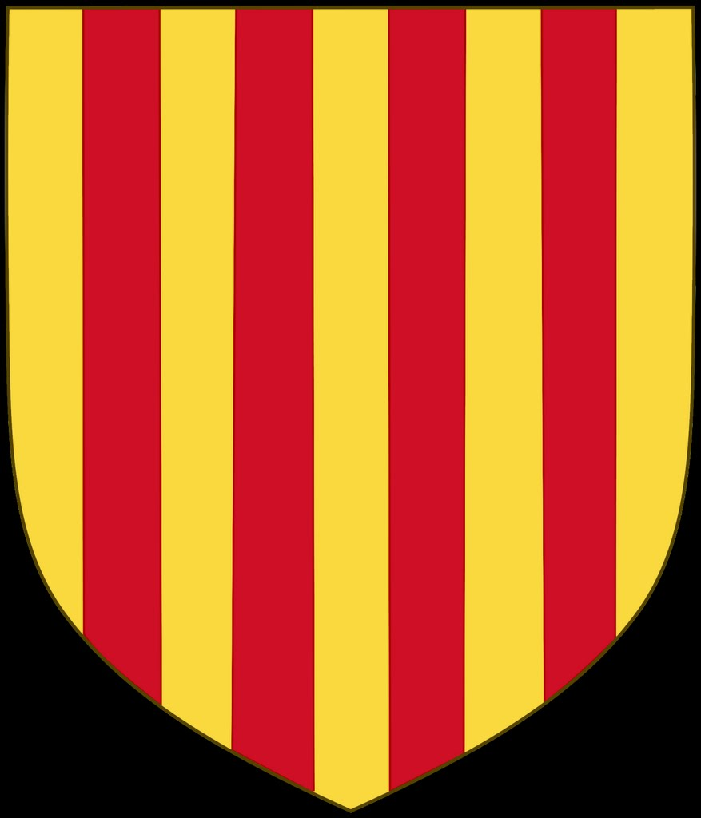
THE FOUR STRIPES IN THE CATALAN FLAG
The legend says that the Catalan count Guifré el Pelós (Wilfred the Hairy) was plain, golden, without any sign.
In a battle in the South of France, the Frank king Carles el Calb (Charles the Bold) asked the Count of Barcelona for help. Guifré el Pelós went up to help him.
In the battle, Franks were already going back, almost defeated, when the Catalans arrived. Then Franks and Catalans made Normands go back North. But in the Normands’ withdrawal a Normand arrow reached Guifré on his chest, and he was seriously wounded.

Slide 15
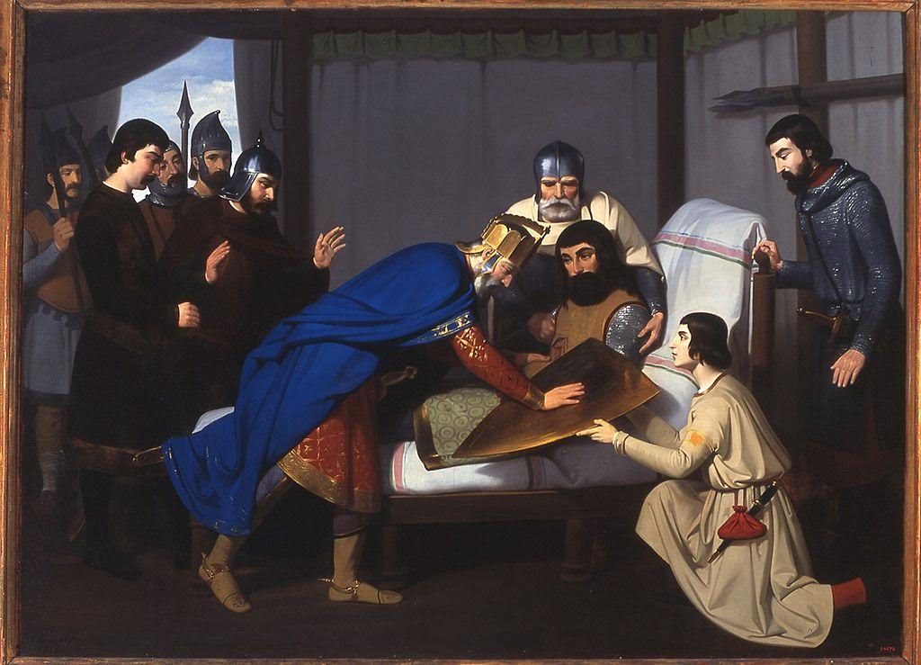
The Frank king, Charles the Bold, visited Guifré in his tent, to thank him.
Guifré told Charles he was so sorry because his coat of arms was still plain, without any pattern or symbol.
Then, the king put his fingers in Guifre’s bleeding wound and after that he smeared his hand across the shield and four blood red lines were drawn, while he declared that would also be his flag.
And since then, the Catalan flag has four red lines on a yellow background.

Slide 16
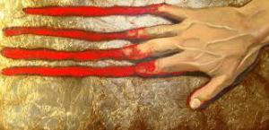
Thank you for your attention.
We hope you enjoyed our (Hi)story :)

